Slide 1

Execution Context
Learning Objectives
Know which methods to use to invoke Apex
Observe how execution context works by executing code in Developer Console
Understand how governor limits impact design patterns

Slide 2
What is Execution Context?
In simple words, this context represents the time between when the code is executed and when it ends.
Consider a scenario where you have a Before Insert trigger on your Account object. In this case the execution context starts when you insert an Account and ends when the trigger code exists

Slide 3
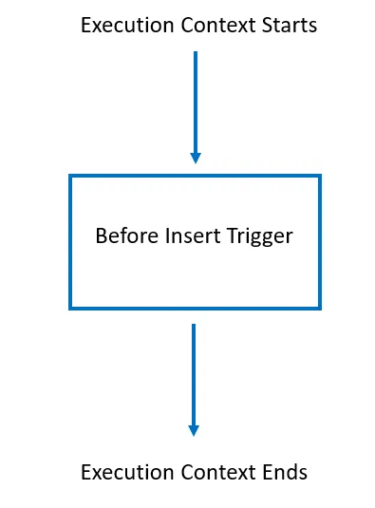
What is Execution Context?

Slide 4
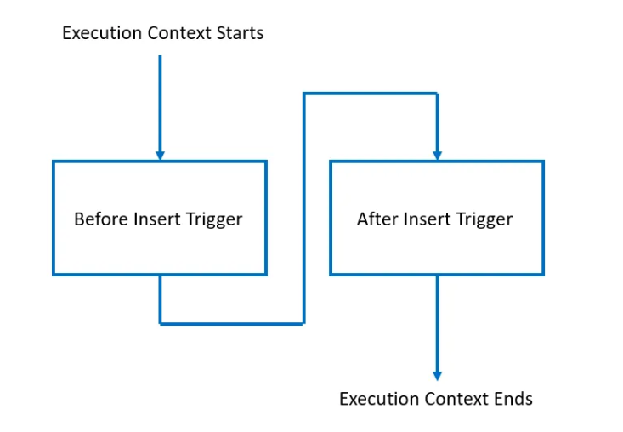
What is Execution Context?
Now let’s assume a more complex scenario where you have multiple triggers on the Account object, A before insert trigger and an after insert trigger. This is how the execution context would look like.

Slide 5
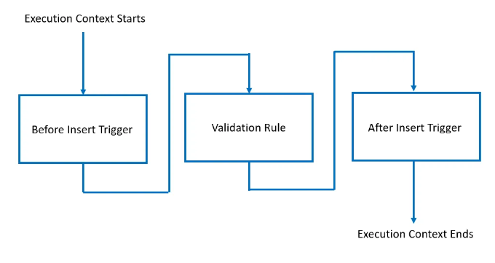
What is Execution Context?
Now let’s assume that I created a validation rule on the Account object, that’s how the execution context would look like.

Slide 6
Why do I have to know the Execution Context?
Static variables: A static variable’s value is the same throughout the execution context and are unique to an execution context.
Governor Limits: Limits are reset between execution contexts.

Slide 7
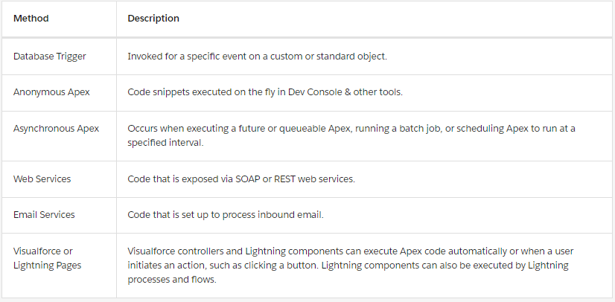
What starts an Execution Context?
Methods of Invoking Apex:->

